Slide 1

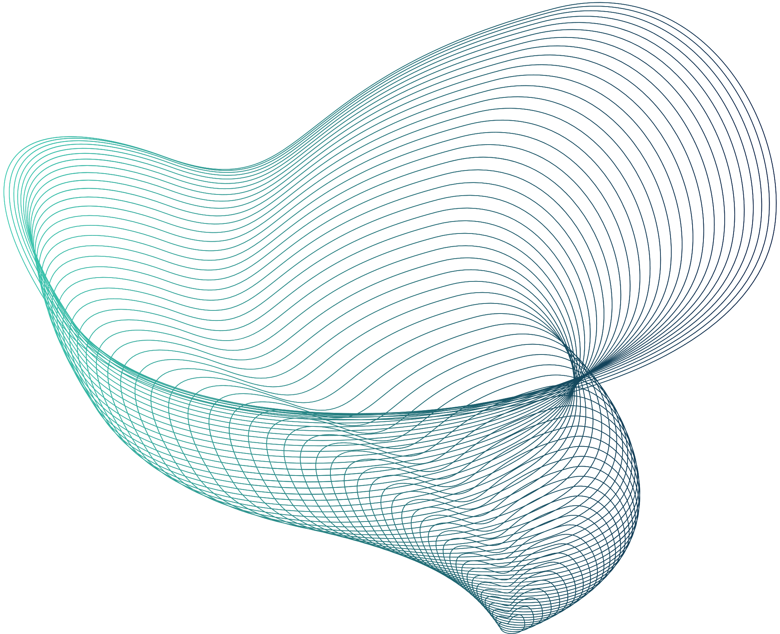
Pakistan Sign Language Interpreter
By Muhammad Hassaan Ibrahim, Muhammad Abbas Bukhari

Slide 2

RECAP
WHY?
WHAT?
HOW?
At least 5% of any country’s population suffers from hearing impairment.
There is a dire need for a national sign language just like national spoken language
Pakistan has a national sign language known as PSL, but this sign language is not widespread.
Our project aims to provide a platform and effective tool to promote PSL and make it easier to interact with and learn.
We have created an Interpreter for PSL which uses CV technologies to accurately translate sign language to text form by just using a camera.

Slide 3
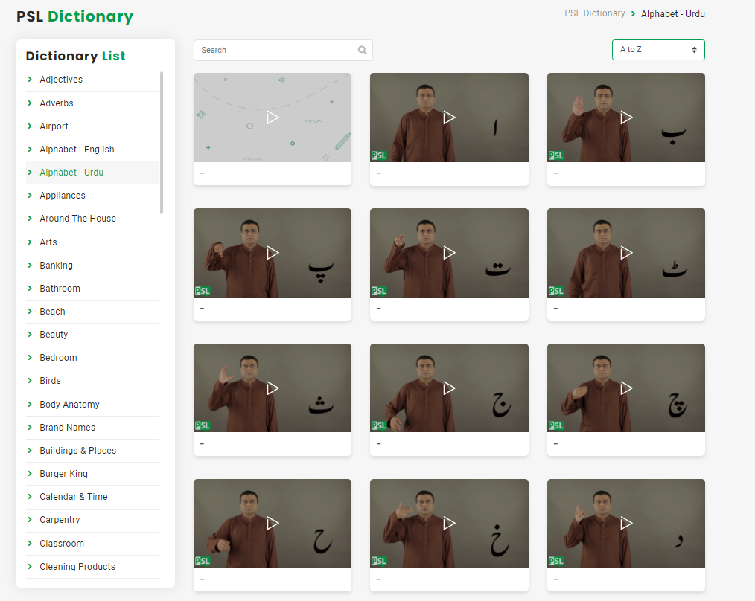
DATASET
Reference for data: PSL Dictionary (https://psl.org.pk/dictionary)
We have 37 classes one class for each urdu alphabets
We recorded 1140 videos of our hands doing the signs for each letter.
Each letter has 30 videos, and each video contains 30 frames.

Slide 4

Step 1
Step 2
Preprocessing of data
we create label map for all the alphabets.
We extract 3D Landmarks of hands from the input videos using media pipe.
Preparing our data for the model
Step 3
Step 4
These landmarks are then labeled with their respective labels.
These Landmarks and labels are then divided into train and test data.

Slide 5
Input to Mediapipe
We input the videos to mediapipe.
Mediapipe extracts 3D landmarks of the hand
These landmarks are labeled and saved as keypoints for each frame as .npy (numpy array files)
Training the Model
Input the keypoints (.npy files) to the model
Model runs for a specified number of epochs.
Stop the model if it overfits
Basic working of the system
Testing
We input from a live feed
Using Mediapipe we extract the landmarks from the feed
We input the landmarks to the model for prediction
Model predicts the output which is displayed on the live feed

Slide 6
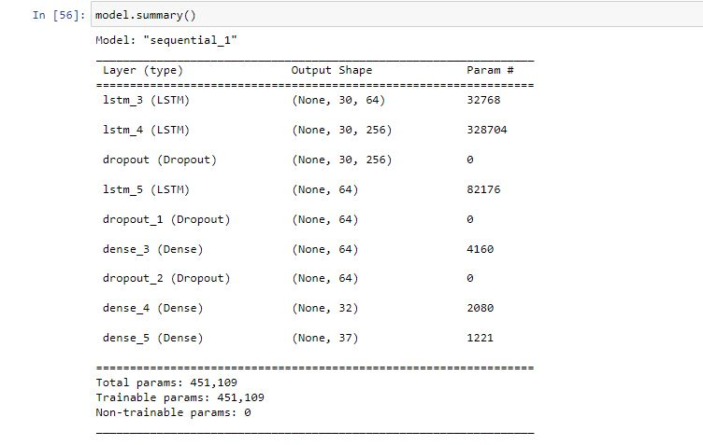
MODEL in detail
Activation function:
Sigmoid for hidden layers
Softmax for output layer
Architecture:
Dropout rate:
30%
Loss function:
Categorical crossentropy
Loss optimization function:
ADAM
Learning rate:
0.001

Slide 7
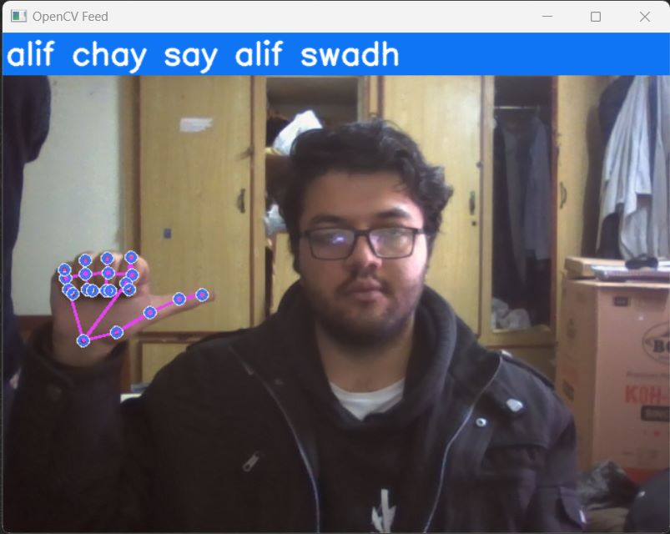
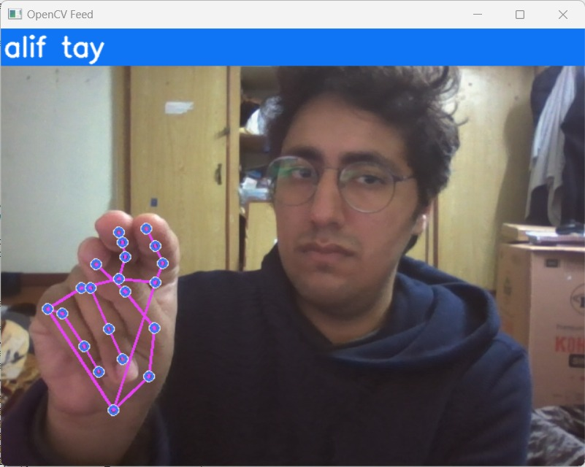
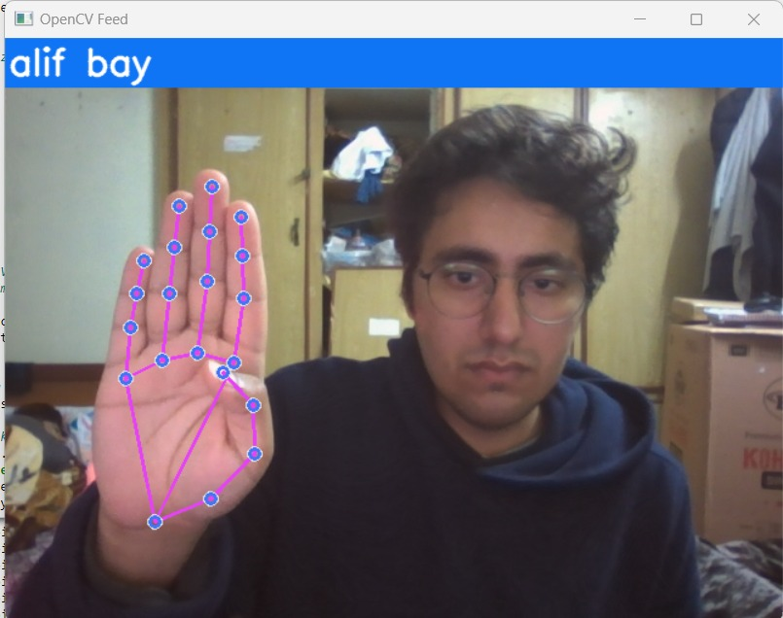
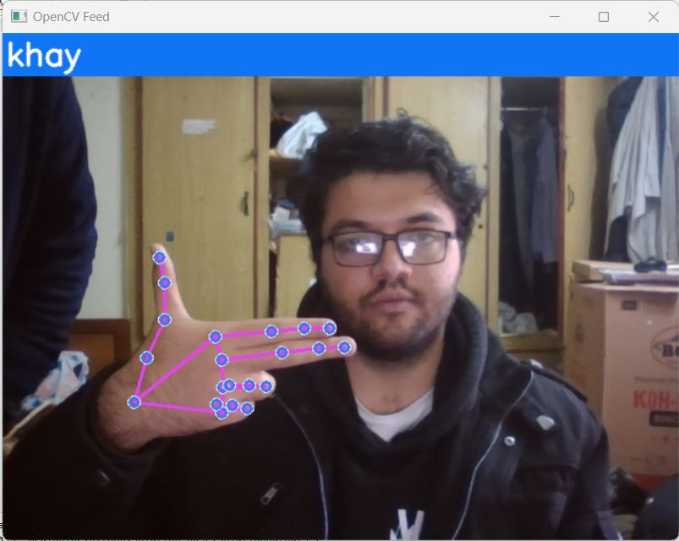
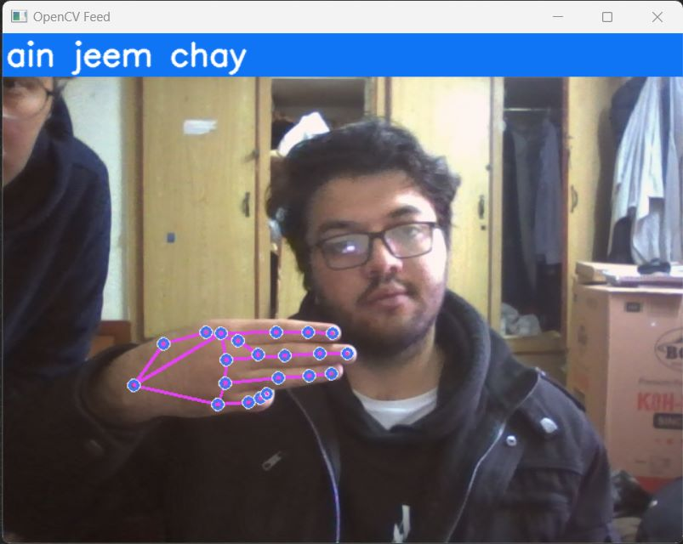
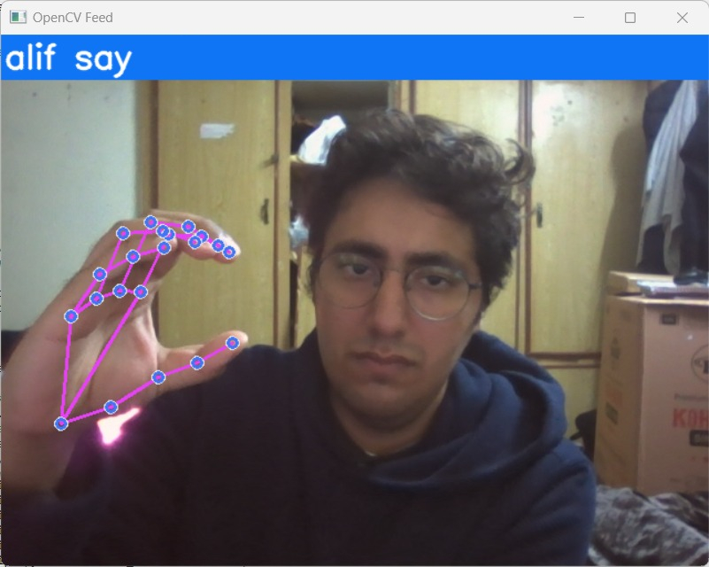
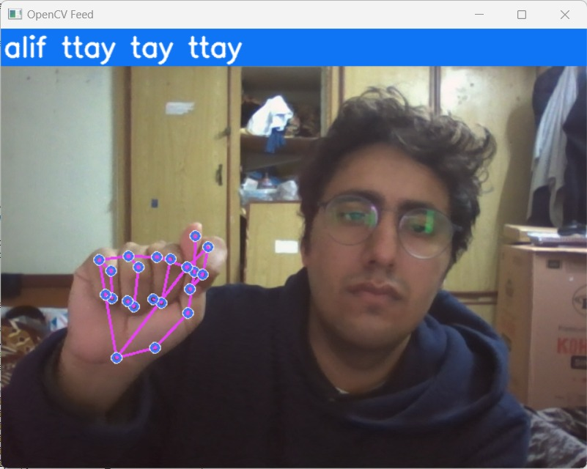
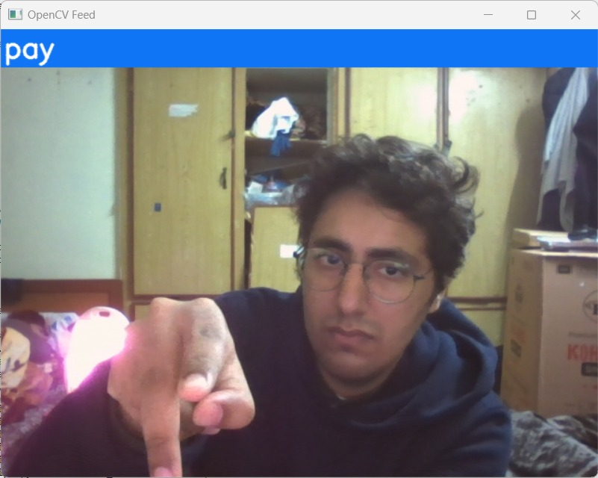
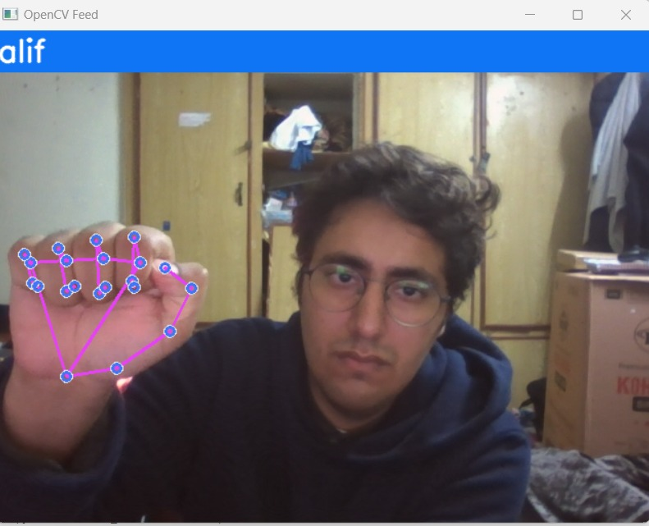
Outputs
These landmarks are then labeled with their respective labels.

Slide 8
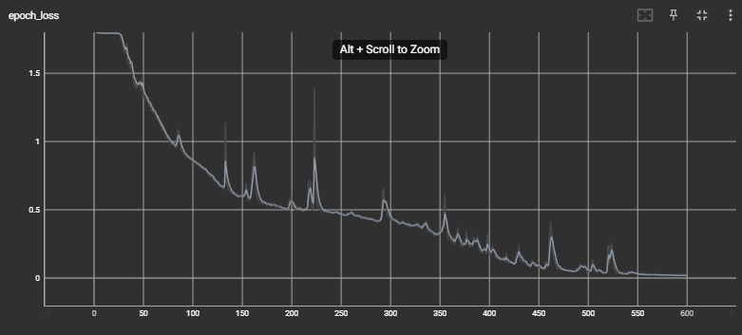
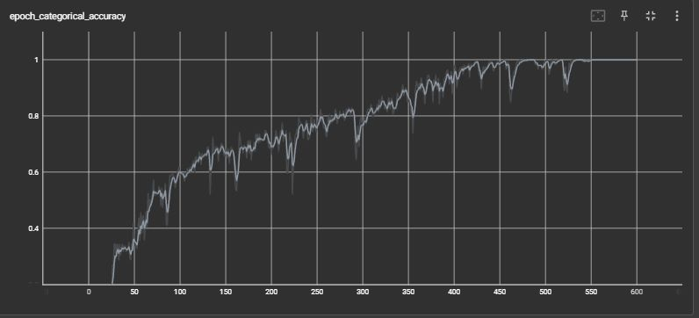
Accuracy and Loss

Slide 9
Thank you

